Slide 1
The "Burning Question" A Technique for Building Engagement and Buy-in for Developmental Evaluation
Rochelle Zorzi and Peter Rudiak-Gould
Canadian Evaluation Society Conference
May 28, 2018
www.cathexisconsulting.ca
Notes:
My colleague Peter and I wanted to share with you a simple technique that we have found helpful for giving some structure to the developmental evaluation process, while still retaining its flexibility.

Slide 2
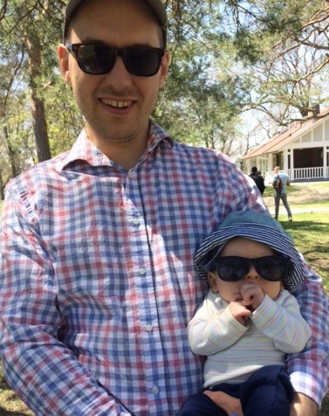
Notes:
Peter could not be here today. He is in Toronto working on his own developmental evaluation project, whose name is Jonah.
Over the past two to three years, Peter and I have been working on some developmental evaluation coaching projects that have been funded by Innoweave. They are small projects with small budgets, and an important goal is to build the program’s capacity to use evaluation.
Our clients were small not-for-profits. They were really excited about doing developmental evaluation. Our role in these projects was to coach them in doing developmental evaluation. The idea was that the program staff would do the data collection and the interpretation and the documentation, and we would provide some guidance and teaching and advice, and help them keep it moving forward.

Slide 3
Developmental evaluation: a lot like sculpting with clay
Notes:
This turned out to be a bit more challenging than we expected.
Because developmental evaluation is a lot like sculpting with clay.
It can be shaped into whatever you need it to be.
But when you are looking at that fresh block of clay, it can be hard to see what the finished product will be.
It looks like anyone could do it. But really, it takes skill, patience and hard work.
So, if you put yourself in the shoes of a a program manager or front line staff who doesn’t do evaluation as their full-time job, how can they know what they’re aiming for or how to get there?
As evaluators, we couldn’t give them any good answers. We couldn’t tell them what questions would be answered. We couldn’t make any promises about what methods would be used, because that depends on what information they need. We couldn’t even estimate how much of their time the process would take. All we could give them was a vague promise that the DE process would give them important information that will help them improve their program. Whatever THAT means.
We worked collaboratively with them to understand the theory of their programs, and to identify areas of risk. We came up with indicators for monitoring their successes and areas of risk, and established some simple data collection processes.
And nothing happened. We had our next meeting, and there was no data to look at. After that, we touched base between meetings with reminders and encouragement. Still no data.
We tried to identify and address barriers. Next meeting… still no data.
We were starting to suspect that they had disengaged. They were very polite about it, but truly, we were getting nowhere. We needed an Intervention.

Slide 4
The burning question
What do you need to know, right now, to design or run the program effectively?
Notes:
Putting our heads together, Peter and I realized that all this program theory stuff might have been too, well, too theoretical.
So in the next meeting, we acknowledged that it wasn’t working, and proposed a different approach. We asked them, “what do you need to know, right now, to do your magic?”
We were meeting over the phone, so we couldn’t see their faces. But as they described what they needed to know, we could hear from the change in their voices that they were now really thinking about it. They were engaged!

Slide 5
How it works
Meeting 1
Meeting 2
Meeting 3+
Choose a burning question
Identify ways to begin answering it
Review findings
Discuss implications
Choose a burning question
Identify ways to begin answering it
Repeat
Notes:
So how does it work? The process is very simple. It happens over a series of DE meetings with the program staff. The meetings might be weekly, monthly or quarterly.
In each DE meeting, program staff identify an urgent question they have about the program. Then we help them to identify some very easy data collection that they can do – over a short period of time - to begin to answer it.
At the next monthly meeting, we reflect on what’s been learned about the previous month’s Burning Question through that data collection, and determine what the implications are for the program design or implementation. Then, we reflect on whether the question has been adequately answered, and choose a burning question for the following month (sometimes the same one as the previous month, if it still feels urgent and needs to be explored further).
Throughout the engagement, we document the questions, the findings, and the evolving thinking about the program.
The process of choosing a burning question might be a bit more elaborate the very first time we do it: Maybe a brainstorming session, then a process of prioritizing where the staff consider how they would use the information, and then coming to consensus about which question is top priority right now. In later meetings, it goes more quickly and naturally.

Slide 6
Burning questions
How can we identify clients who are most likely to benefit from the program?
How much programming are clients actually getting?
How important is this component of the program?
What do our clients value most about the program?
Which benefits should we emphasize when we talk about the project?
What works for getting partners to support key activities?
Notes:
These are examples of some of the burning questions our clients have asked.

Slide 7
Three things we’ve learned about burning questions

Slide 8
Lesson 1: Make sure the burning question is driven by program staff, not by evaluators. It should be important to them, and urgent.
Notes:
The burning question needs to feel owned by the program staff rather than the evaluators. It has to feel (not just be) important and urgent to them. If program staff aren’t sure what burning question to choose, you can ask “What’s keeping you up at night recently?”
The burning question doesn’t need to change every month. If it still feels urgent and hasn’t yet been fully or satisfactorily answered, then it can be carried forward to the next month. It is fine to ask it again, as long as you are making a bit of headway in answering it each month (or at least learning how to learn about it).

Slide 9
Lesson 2: Use the burning questions as a tool to introduce and generate buy-in for ongoing monitoring and CQI
Traditional approach
Burning question approach
1. Logic model / program theory
4. Collect data – blah ☹
2. Decide what is important to track
3. Develop indicators
5. Discuss results
6. Refine the program
1 Identify burning question
3. Discuss results
2. Collect data that is important! ☺
4. Refine the program
5. Identify other burning questions
6. Build a set of useful indicators
Notes:
A burning question can be an entrée into program monitoring and continuous quality improvement. It has clear advantages over more traditional approaches, where it can be hard to gain momentum if staff are responsible for collecting the data.
When we look at the processes side-by-side, no wonder it is hard! Using the traditional approach, things don’t start to get real for program staff until step 5 – and then, only if you happen to have landed on the indicators that are important to them.
Using the burning question approach, they get rewarded for their data collection efforts really quickly, which motivates them to do more.
Over time, this can lead to the identification of performance indicators that are truly meaningful to the program. If a particular kind of data collection appears again and again, then it might just be a good idea to collect that data as a matter of course going forward. That becomes program monitoring. As trust in the process builds, program staff can start to tackle more ambitious evaluation activities: bigger questions with longer-term data gathering, KPIs, a dashboard…But they won’t do any of this until they’ve gotten a flavor of evidence-based decision-making – and that’s where the burning question shines.

Slide 10
Lesson 3: Choose simple and easy data collection activities
Notes:
Making time for data collection is a tough nut to crack. It is a struggle even in programs where staff totally understand the value of the information, and have the skills to collect it. They are busy developing and refining the program, and it is hard to divert attention to data, even though they know the information will be really helpful. It is best to choose quite simple and easy data collection techniques to answer the burning question, at least to start out with. The goal is to rack up some early wins and demonstrate the value of an evaluative approach and evidence-based decision-making
So something as simple as “Ask three participants why they came to the drop-in clinic today, and write down their answers” or “Look up StatsCan data on unemployment rates in the two neighbourhoods that we work in” could be enough for one month.
More sophisticated data collection can come later, but at first it’s important to build comfort with the process and get people excited about how much they can improve the program by collecting just a bit of extra data.

Slide 11
What our clients have said
The burning question keeps us focused on what we need, in both the short term and long term.
It helps us articulate what we are struggling with
We have carried through using the burning question idea and have incorporated into our monthly meetings
Notes:
We can’t say the burning question has made Developmental Evaluation easy, but it has helped provide a bit of structure and predictability. Program staff won’t know what question they’ll be tackling each month, but at least they know that there’ll be a question, and that it will be a question that is important to them.
Our clients have found it helpful enough that they have continued using it even after our role on the evaluation is done. They have also pointed out that even the act of framing the question has been helpful. Sometimes, they find solutions just by virtue of articulating the challenges they have been grappling with.

Slide 12
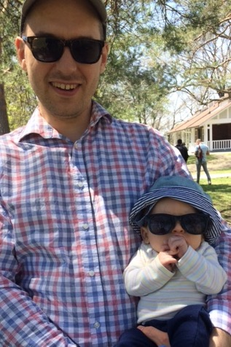
Peter’s burning questions: 1. Is there a way of making you nap that doesn't involve bouncing on an exercise ball in a pitch-black room for 2 hours? 2. Why do you cry when I put a hat on you? 3. What's that smell?

